Slide 1
CAPSTONE PROJECT-
Northwind traders sales analysis
Chawhan Bhoomika

Slide 2
INTRODUCTION
This Power BI project focuses on analyzing sales performance using the Northwind dataset. It visualizes KPIs such as Total Sales, Orders, Customers, and Average Order Value, offering actionable insights into business growth, customer behavior, and employee performance.

Slide 3

Project Objectives
• To visualize key sales performance indicators.
• To analyze top products, customers, and employees.
• To study regional and category-wise sales performance.
• To build an interactive, data-driven dashboard for better decisions.

Slide 4
Dataset Description – Northwind Trader
The Northwind dataset contains the sales data of a fictitious company called “Northwind Traders.”
Northwind Traders is a global food import and export business that sells specialty food products worldwide.
This dataset simulates real-world business operations and provides data across multiple domains:
• Customers
• Employees
• Orders and Order Details
• Products, Categories, and Suppliers
• Shippers (logistics details)
It serves as a comprehensive data source for analyzing sales performance, employee efficiency, and customer relationships using Power BI.

Slide 5
Table Explanation
Table Name | Description / Purpose
Customers | Stores details about the company’s customers, including names, contact information, and locations.
Employees | Contains employee information such as names, titles, hire dates, and reporting hierarchy.
Orders | Holds order-level data, including customer, employee, shipping details, and order dates.
Order Details | Contains line-item details for each order — products sold, quantities, prices, and discounts.
Products | Includes product details such as category, supplier, unit price, stock levels, and reorder information.
Suppliers | Lists all suppliers providing products, along with contact and location information.
Shippers | Stores details about shipping companies responsible for product delivery.
Categories | Defines product categories used for grouping and analysis in sales reports.
Northwind Traders

Slide 6
Tools and Technologies
Power BI – Data modeling and visualization.
Excel – Data preparation and analysis.
SQL – Data extraction and transformation.
DAX – Calculations for KPIs and measures.

Slide 7





Data connection-power bi
Step 1
Step 2
Step 3
Step 4
Step 5
Connecting via CSV / Excel
Open Power BI Desktop → Click Get Data → Text/CSV (or Excel).
Browse and select your dataset file (e.g., Customers.csv, Orders.csv).
Preview the data and click Load.
Use Power Query to clean and transform data:

Slide 8
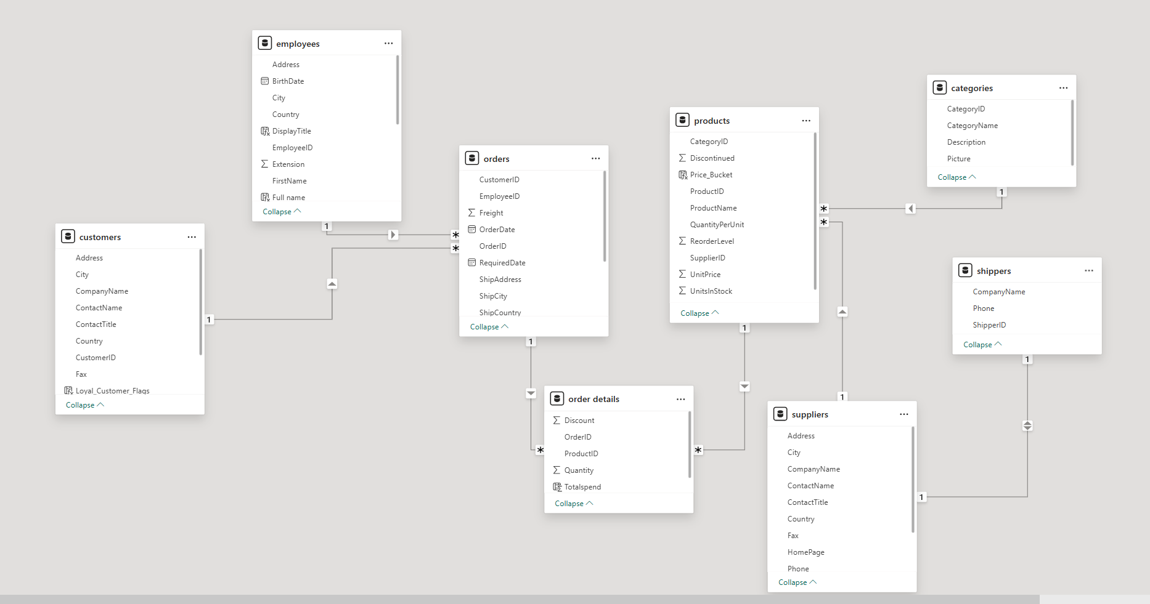
Data Model Overview
The data model in Power BI integrates multiple tables from the Northwind dataset to enable efficient analysis and cross-filtering between entities.
The model follows a Star Schema design — where the Orders and Order Details tables serve as the fact tables, while other tables (Customers, Employees, Products, Categories, and Shippers) act as dimension tables

Slide 9
Dashboard Design and Layout
The Sales Performance Dashboard was designed with a clear, modern, and user-friendly layout to ensure effective data storytelling and quick insight extraction.
Design Approach:
• Adopted a dark gradient theme (Navy → Teal) for better visual focus and contrast.
• Used Power BI Cards for KPIs such as Total Sales, Orders, and Average Order Value.
• Included bar, line, and map visuals to show product trends, sales over time, and regional distribution.
• Applied filters and slicers (funnel icons) for interactivity by year, category, region, and employee.
• Incorporated page navigator buttons for seamless page transitions.
Dashboard Pages Overview:
1️⃣ Overview Page – Summary of key metrics and trends.
2️⃣ Product Performance – Top products, categories, and discounts.
3️⃣ Customer Analysis – Customer segments, loyalty, and sales by region.
4️⃣ Employee Performance – Employee sales comparison and top performer.
5️⃣ Order Analysis – Order value distribution, freight, and shipping duration.
Goal: To create an interactive and visually appealing dashboard that helps decision-makers easily monitor performance.

Slide 10
DAX Measures and KPIs
To enhance data analysis and interactivity, several DAX (Data Analysis Expressions) measures were created in Power BI.
These measures help calculate key business performance metrics (KPIs) and provide dynamic insights for visualization.
Key DAX Measures Used:
Total Sales = SUMX('Order Details', [UnitPrice] * [Quantity] * (1 - [Discount]))
Total Orders = COUNTROWS(Orders)
Average Order Value (AOV) = [Total Sales] / DISTINCTCOUNT(Orders[OrderID])
Total Customers = DISTINCTCOUNT(Customers[CustomerID])
Top Performer (Employee) =
TOPN(1, SUMMARIZE(Employees, Employees[FullName], "Sales", [Total Sales]), [Total Sales], DESC)
Profit Margin = ([Total Sales] - [Cost]) / [Total Sales] (if cost data available)
Purpose:
Enables real-time calculations within visuals.
Simplifies KPI monitoring and trend analysis.
Supports performance tracking by product, customer, and employee.

Slide 11
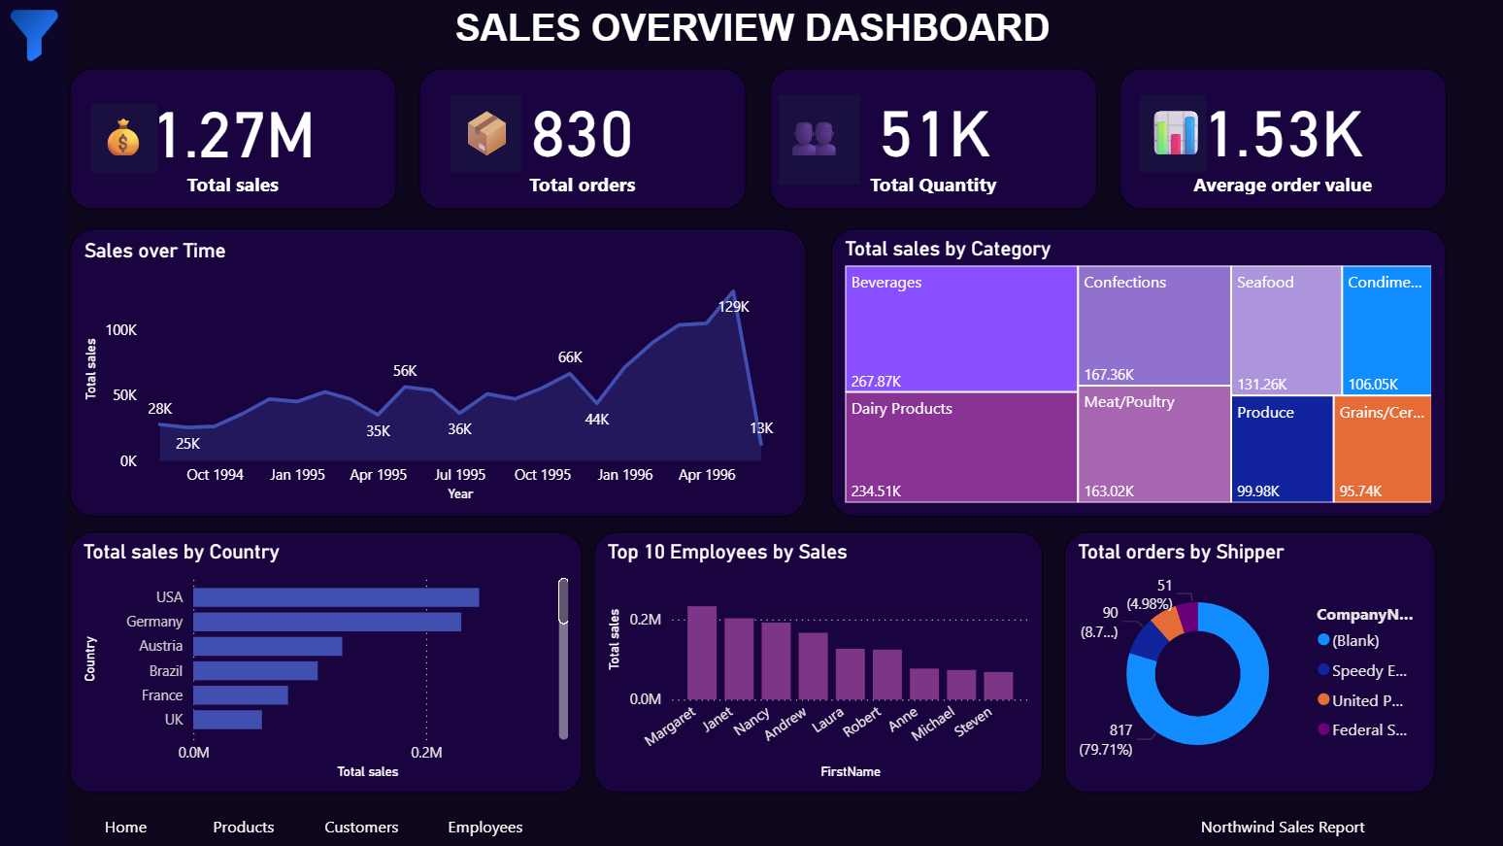

Slide 12
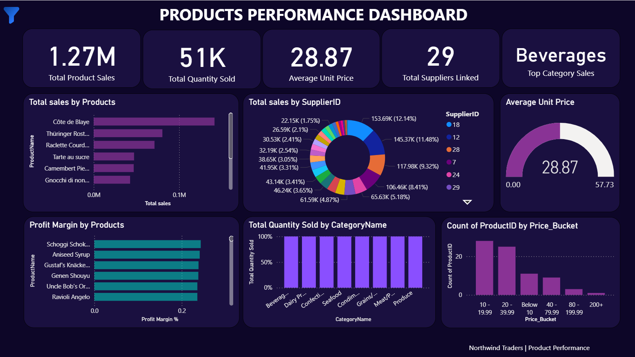

Slide 13
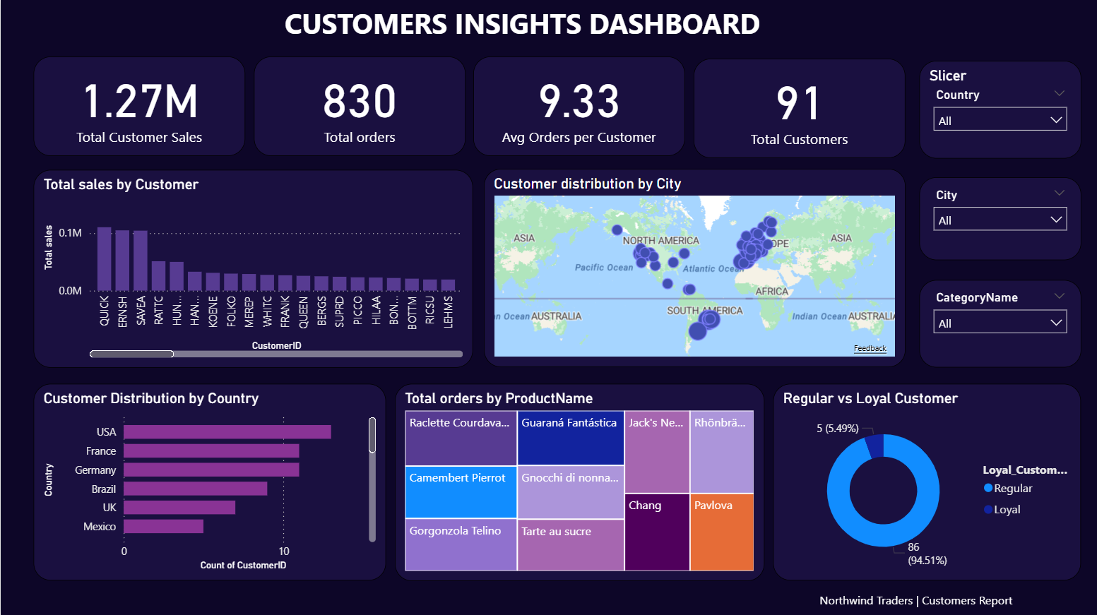

Slide 14
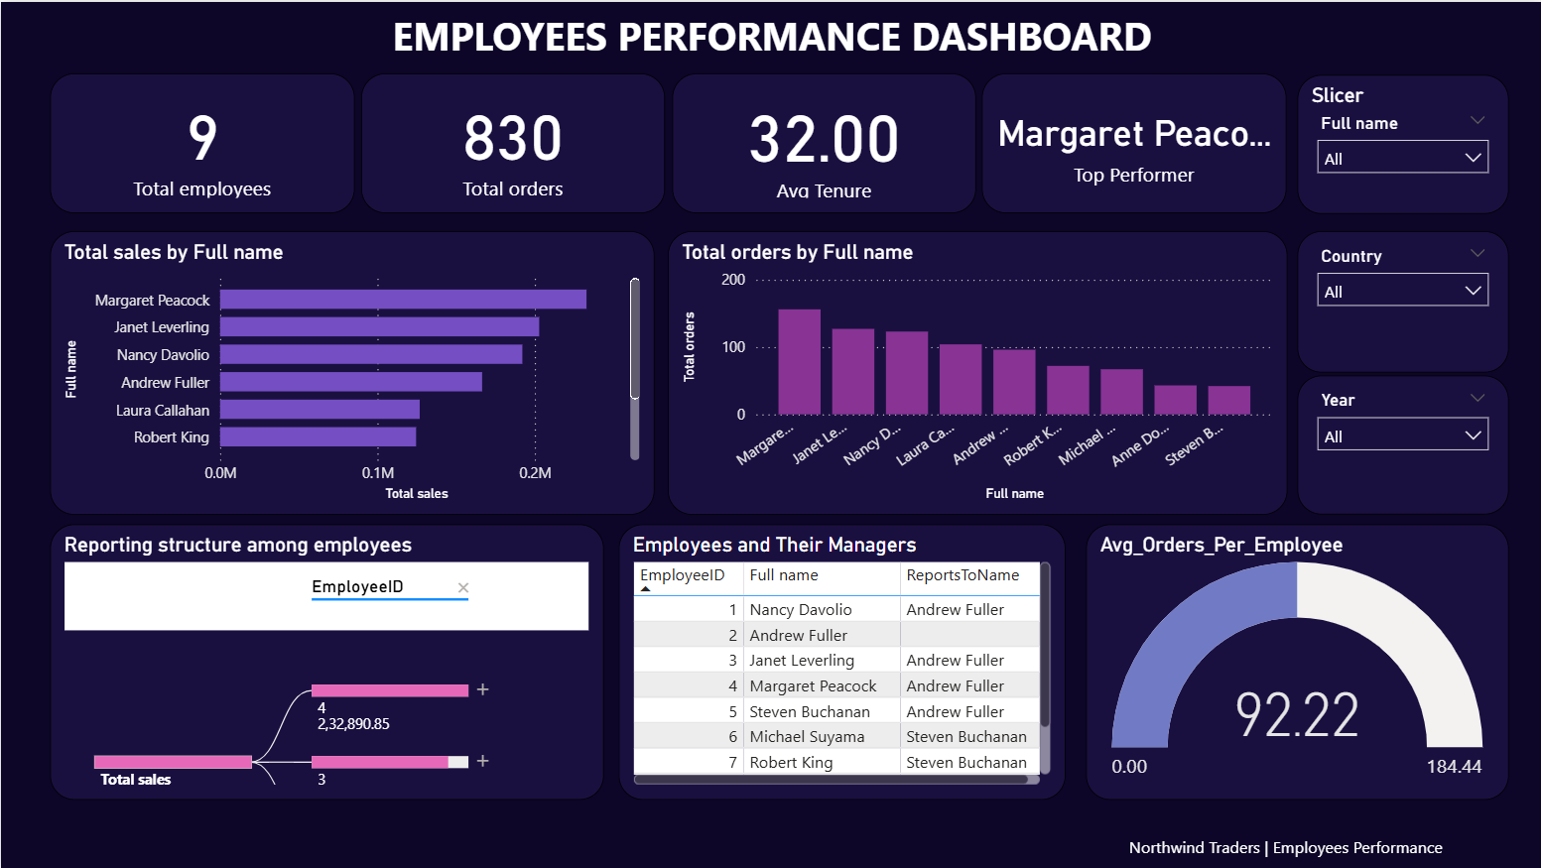

Slide 15
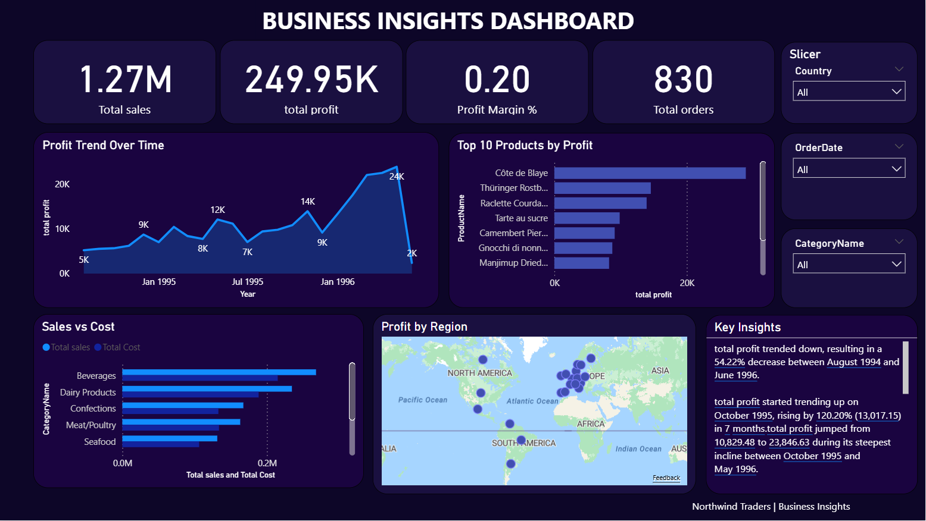

Slide 16
Key insigths
The USA and Germany generate the highest sales revenue.
Beverages and Condiments are the best-selling product categories.
Senior employees show higher average sales performance.
Order volume peaks in the last quarter of each year.
Loyal customers contribute significantly to total revenue.

Slide 17
Conclusion
The Sales Performance Dashboard delivers comprehensive insights into business operations. It enables stakeholders to track KPIs, evaluate employee productivity, identify top-performing products, and understand customer behavior. Power BI provides an interactive and effective platform for strategic decision-making.

Slide 18
Future enhancements
• Integrate real-time sales data.
• Add forecasting and predictive analytics.
• Automate report refresh and scheduling.
• Expand analysis to include inventory and supplier data.

Slide 19
THANK YOU
Chawhan Bhoomika
🎓 BCA / Data Analytics Student
💼 Passionate about Business Intelligence and Data Visualization
📧 bhoomikachawhan07@gmail.com
🌐 LinkedIn Profile

